Slide 1

Local Area Networks
Overview of LANs
Ethernet
Addressing and ARP
Switches and VLAN
802.11 Wireless LAN

Slide 2
Overview of LANs

Slide 3
What is a LAN?
Local area means:
Private ownership
  freedom from regulatory constraints of WANs
Short distance (~1km) between computers
  low cost
  very high-speed, relatively error-free communication
  complex error control unnecessary
Machines are constantly moved
  Keeping track of location of computers a chore
  Simply give each machine a unique address
  Broadcast all messages to all machines in the LAN
Need a medium access control (MAC) protocol

Slide 4
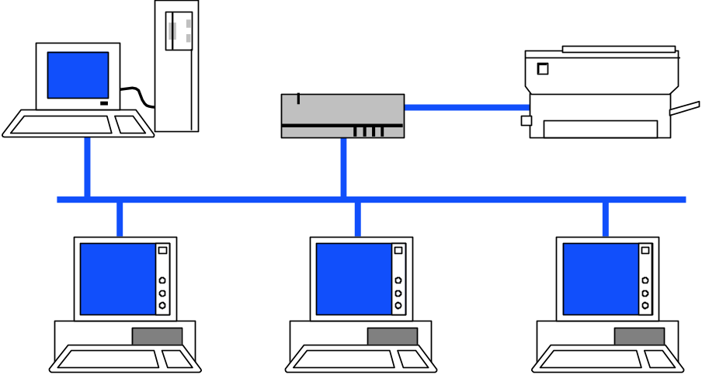

Typical Early-day LAN Structure
Transmission Medium
Network Interface Card (NIC)
Unique MAC “physical” address
RAM
Ethernet Processor
ROM
RAM

Slide 5
Data Link Layer in LAN
In IEEE 802.1, Data Link Layer divided into:
Medium Access Control Sublayer
  Coordinate access to medium
  Connectionless frame transfer service
  Machines identified by MAC/physical address
  Broadcast frames with MAC addresses
Logical Link Control Sublayer
  Between Network layer & MAC sublayer

Slide 6
MAC Sub-layer
IEEE 802
OSI
Network layer
Network layer
LLC
802.2 Logical link control
Data link
layer
802.3
CSMA-CD
802.5
Token Ring
802.11
Wireless
LAN
Other
LANs
MAC
Various physical layers
Physical
layer
Physical
layer

Slide 7
Logical Link Control Sub-layer
IEEE 802.2: LLC enhances service provided by MAC
A
C
A
Reliable frame service
C
Unreliable Datagram Service
LLC
LLC
LLC
MAC
MAC
MAC
MAC
MAC
MAC
PHY
PHY
PHY
PHY
PHY
PHY

Slide 8
Logical Link Control Services
Type 1: Unacknowledged connectionless service
  Unnumbered frame mode of HDLC
Type 2: Reliable connection-oriented service
  Asynchronous balanced mode of HDLC
Type 3: Acknowledged connectionless service
Additional addressing
  A workstation has a single MAC physical address
  Can handle several logical connections, distinguished by their SAP (service access points).

Slide 9
LLC PDU Structure
1 byte
1
1 or 2 bytes
1
Destination
SAP Address
Source
SAP Address
Control
Information
Destination SAP Address
Source SAP Address
I/G
C/R
1
7 bits
1
7 bits
I/G = Individual or group address
C/R = Command or response frame
Examples of SAP Addresses:
06 IP packet
E0 Novell IPX
FE OSI packet
AA SubNetwork Access protocol (SNAP)

Slide 10
Encapsulation of MAC frames
IP Packet
IP
LLC PDU
LLC Header
Data
MAC Header
FCS

Slide 11
Ethernet

Slide 12

A bit of history…
1970 ALOHAnet radio network deployed in Hawaiian islands
1973 Metcalf and Boggs invent Ethernet, random access in wired net
1979 DIX Ethernet II Standard
1985 IEEE 802.3 LAN Standard (10 Mbps)
1995 Fast Ethernet (100 Mbps)
1998 Gigabit Ethernet
2002 10 Gigabit Ethernet
Ethernet is the dominant LAN standard
Metcalf’s Sketch

Slide 13
IEEE 802.3 MAC: Ethernet
MAC Protocol:
CSMA/CD
Slot Time is the critical system parameter
  upper bound on time to detect collision
  upper bound on time to acquire channel
  upper bound on length of frame segment generated by collision
  quantum for retransmission scheduling
  max{round-trip propagation, MAC jam time}

Slide 14
IEEE 802.3 Original Parameters
Transmission Rate: 10 Mbps
Min Frame: 512 bits = 64 bytes
Slot time: 512 bits/10 Mbps = 51.2 μsec
  51.2 μsec x 2x10⁵ km/sec =10.24 km, 1 way
  5.12 km round trip distance
Max Length: 2500 meters + 4 repeaters
Each x10 increase in bit rate, must be accompanied by x10 decrease in distance

Slide 15


IEEE 802.3 Physical Layer
Table 6.2 IEEE 802.3 10 Mbps medium alternatives
 | 10base5 | 10base2 | 10baseT | 10baseFX
Medium | Thick coax | Thin coax | Twisted pair | Optical fiber
Max. Segment Length | 500 m | 200 m | 100 m | 2 km
Topology | Bus | Bus | Star | Point-to-point link
Hubs & Switches!
(a)
transceivers
(b)
Thick Coax: Stiff, hard to work with
T connectors flaky

Slide 16
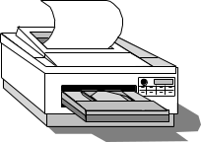
Ethernet Hubs & Switches
Single collision domain
High-Speed backplane or interconnection fabric
(a)
●     
(b)
●   
Twisted Pair Cheap
Easy to work with
Reliable
Star-topology CSMA-CD
Twisted Pair Cheap
Bridging increases scalability
Separate collision domains
Full duplex operation

Slide 17
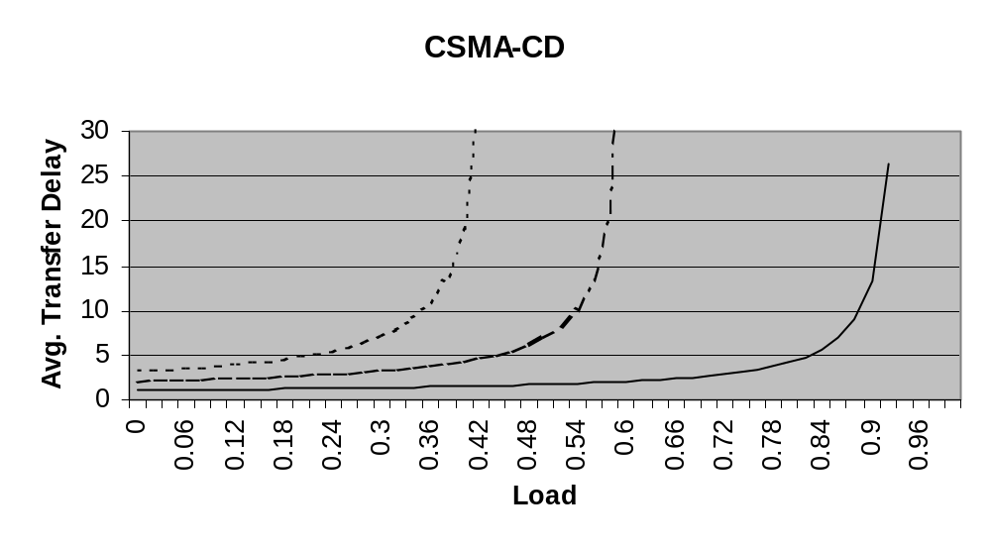
Ethernet Scalability
a = .1
a = .01
a = .2
CSMA-CD maximum throughput depends on normalized delay-bandwidth product a=t_{prop}/X (X=L/R)
x10 increase in bit rate = x10 decrease in X
To keep a constant need to either: decrease t_{prop} (distance) by x10; or increase frame length x10

Slide 18
Fast Ethernet
Table 6.4 IEEE 802.3 100 Mbps Ethernet medium alternatives
 | 100baseT4 | 100baseT | 100baseFX
Medium | Twisted pair category 3 UTP 4 pairs | Twisted pair category 5 UTP two pairs | Optical fiber multimode Two strands
Max. Segment Length | 100 m | 100 m | 2 km
Topology | Star | Star | Star
To preserve compatibility with 10 Mbps Ethernet:
Same frame format, same interfaces, same protocols
Hub topology only with twisted pair & fiber
Bus topology & coaxial cable abandoned
Category 3 twisted pair (ordinary telephone grade) requires 4 pairs
Category 5 twisted pair requires 2 pairs (most popular)

Slide 19
Gigabit Ethernet
Table 6.3 IEEE 802.3 1 Gbps Fast Ethernet medium alternatives
 | 1000baseSX | 1000baseLX | 1000baseCX | 1000baseT
Medium | Optical fiber multimode Two strands | Optical fiber single mode Two strands | Shielded copper cable | Twisted pair category 5 UTP
Max. Segment Length | 550 m | 5 km | 25 m | 100 m
Topology | Star | Star | Star | Star
Slot time increased to 512 bytes
Small frames need to be extended to 512 B
Frame bursting to allow stations to transmit burst of short frames
Frame structure preserved but CSMA-CD essentially abandoned
Extensive deployment in backbone of enterprise data networks and in server farms
Most prevalent LAN today

Slide 20
10 Gigabit Ethernet
Table 6.5 IEEE 802.3 10 Gbps Ethernet medium alternatives
 | 10GbaseSR | 10GBaseLR | 10GbaseEW | 10GbaseLX4
Medium | Two optical fibers Multimode at 850 nm 64B66B code | Two optical fibers Single-mode at 1310 nm 64B66B | Two optical fibers Single-mode at 1550 nm SONET compatibility | Two optical fibers multimode/single-mode with four wavelengths at 1310 nm band 8B10B code
Max. Segment Length | 300 m | 10 km | 40 km | 300 m – 10 km
Frame structure preserved
CSMA-CD protocol officially abandoned
LAN PHY for local network applications
WAN PHY for wide area interconnection using SONET OC-192c
Extensive deployment in metro networks anticipated

Slide 21

Typical Ethernet Deployment
Server farm
Server
Server
Server
Gigabit Ethernet links
Switch/router
Switch/router
Gigabit Ethernet links
Server
Ethernet switch
Ethernet switch
Server
Ethernet switch
Server
100 Mbps links
100 Mbps links
100 Mbps links
Hub
Hub
Hub
10 Mbps links
10 Mbps links
10 Mbps links
Department A
Department B
Department C

Slide 22
MAC addresses and ARP

Slide 23
MAC addresses and ARP
32-bit IP address:
  network-layer address for interface
  used for layer 3 (network layer) forwarding
MAC (or LAN or physical or Ethernet) address:
  function: used ‘locally” to get frame from one interface to another physically-connected interface (same network, in IP-addressing sense)
  48 bit MAC address (for most LANs) burned in NIC ROM, also sometimes software settable
  e.g.: 1A-2F-BB-76-09-AD

Slide 24

LAN addresses and ARP
each adapter on LAN has unique LAN address
1A-2F-BB-76-09-AD
LAN
(wired or
wireless)
adapter
71-65-F7-2B-08-53
58-23-D7-FA-20-B0
0C-C4-11-6F-E3-98

Slide 25
LAN addresses (more)
MAC address allocation administered by IEEE
manufacturer buys portion of MAC address space (to assure uniqueness)
analogy:
  MAC address: like Social Security Number
  IP address: like postal address
MAC flat address ➜ portability
  can move LAN card from one LAN to another
IP hierarchical address not portable
  address depends on IP subnet to which node is attached

Slide 26


ARP: address resolution protocol
Question: how to determine
interface’s MAC address, knowing its IP address?
ARP table: each IP node (host, router) on LAN has table
  IP/MAC address mappings for some LAN nodes:
< IP address; MAC address; TTL>
  TTL (Time To Live): time after which address mapping will be forgotten (typically 20 min)
137.196.7.78
1A-2F-BB-76-09-AD
137.196.7.23
137.196.7.14
LAN
71-65-F7-2B-08-53
58-23-D7-FA-20-B0
0C-C4-11-6F-E3-98
137.196.7.88

Slide 27
ARP protocol: same LAN
A wants to send datagram to B
  B’s MAC address not in A’s ARP table.
A broadcasts ARP query packet, containing B's IP address
  dest MAC address = FF-FF-FF-FF-FF-FF
  all nodes on LAN receive ARP query
B receives ARP packet, replies to A with its (B's) MAC address
  frame sent to A’s MAC address (unicast)
A caches (saves) IP-to-MAC address pair in its ARP table until information becomes old (times out)
  soft state: information that times out (goes away) unless refreshed
ARP is “plug-and-play”:
  nodes create their ARP tables without intervention from net administrator

Slide 28
ARP example
H1 wants to learn physical address of H3 -> broadcasts an ARP request
H1
H2
H3
H4
150.100.76.20
150.100.76.21
150.100.76.22
150.100.76.23
ARP request (what is the MAC address of 150.100.76.22?)
Every host receives the request, but only H3 reply with its physical address
H1
H2
H3
H4
ARP response (my MAC address is 08:00:5a:3b:94)

Slide 29
Addressing: routing to another LAN
walkthrough: send datagram from A to B via R
  focus on addressing – at IP (datagram) and MAC layer (frame)
  assume A knows B’s IP address
  assume A knows IP address of first hop router, R (how?)
  assume A knows R’s MAC address (how?)
A
B
R
111.111.111.111
222.222.222.222
74-29-9C-E8-FF-55
49-BD-D2-C7-56-2A
222.222.222.220
1A-23-F9-CD-06-9B
111.111.111.112
111.111.111.110
222.222.222.221
CC-49-DE-D0-AB-7D
E6-E9-00-17-BB-4B
88-B2-2F-54-1A-0F

Slide 30
Addressing: routing to another LAN
A creates IP datagram with IP source A, destination B
A creates link-layer frame with R's MAC address as dest, frame contains A-to-B IP datagram
MAC src: 74-29-9C-E8-FF-55
MAC dest: E6-E9-00-17-BB-4B
IP
Eth
Phy
IP src: 111.111.111.111
IP dest: 222.222.222.222
A
B
R
111.111.111.111
222.222.222.222
74-29-9C-E8-FF-55
49-BD-D2-C7-56-2A
222.222.222.220
1A-23-F9-CD-06-9B
111.111.111.112
111.111.111.110
222.222.222.221
CC-49-DE-D0-AB-7D
E6-E9-00-17-BB-4B
88-B2-2F-54-1A-0F

Slide 31
Addressing: routing to another LAN
frame sent from A to R
frame received at R, datagram removed, passed up to IP
MAC src: 74-29-9C-E8-FF-55
MAC dest: E6-E9-00-17-BB-4B
IP src: 111.111.111.111
IP dest: 222.222.222.222
IP
Eth
Phy
IP src: 111.111.111.111
IP dest: 222.222.222.222
IP
Eth
Phy
A
B
R
111.111.111.111
222.222.222.222
74-29-9C-E8-FF-55
49-BD-D2-C7-56-2A
222.222.222.220
1A-23-F9-CD-06-9B
111.111.111.112
111.111.111.110
222.222.222.221
CC-49-DE-D0-AB-7D
E6-E9-00-17-BB-4B
88-B2-2F-54-1A-0F

Slide 32
Addressing: routing to another LAN
R forwards datagram with IP source A, destination B
R creates link-layer frame with B's MAC address as dest, frame contains A-to-B IP datagram
MAC src: 1A-23-F9-CD-06-9B
MAC dest: 49-BD-D2-C7-56-2A
IP
Eth
Phy
IP
Eth
Phy
IP src: 111.111.111.111
IP dest: 222.222.222.222
A
B
R
111.111.111.111
222.222.222.222
74-29-9C-E8-FF-55
49-BD-D2-C7-56-2A
222.222.222.220
1A-23-F9-CD-06-9B
111.111.111.112
111.111.111.110
222.222.222.221
CC-49-DE-D0-AB-7D
E6-E9-00-17-BB-4B
88-B2-2F-54-1A-0F

Slide 33
Addressing: routing to another LAN
R forwards datagram with IP source A, destination B
R creates link-layer frame with B's MAC address as dest, frame contains A-to-B IP datagram
MAC src: 1A-23-F9-CD-06-9B
MAC dest: 49-BD-D2-C7-56-2A
IP
Eth
Phy
IP
Eth
Phy
IP src: 111.111.111.111
IP dest: 222.222.222.222
A
B
R
111.111.111.111
222.222.222.222
74-29-9C-E8-FF-55
49-BD-D2-C7-56-2A
222.222.222.220
1A-23-F9-CD-06-9B
111.111.111.112
111.111.111.110
222.222.222.221
CC-49-DE-D0-AB-7D
E6-E9-00-17-BB-4B
88-B2-2F-54-1A-0F

Slide 34
Addressing: routing to another LAN
R forwards datagram with IP source A, destination B
R creates link-layer frame with B's MAC address as dest, frame contains A-to-B IP datagram
MAC src: 1A-23-F9-CD-06-9B
MAC dest: 49-BD-D2-C7-56-2A
IP src: 111.111.111.111
IP dest: 222.222.222.222
IP
Eth
Phy
A
B
R
111.111.111.111
222.222.222.222
74-29-9C-E8-FF-55
49-BD-D2-C7-56-2A
222.222.222.220
1A-23-F9-CD-06-9B
111.111.111.112
111.111.111.110
222.222.222.221
CC-49-DE-D0-AB-7D
E6-E9-00-17-BB-4B
88-B2-2F-54-1A-0F

Slide 35
Switches and VLAN

Slide 36
Ethernet switch
link-layer device: takes an active role
  store, forward Ethernet frames
  examine incoming frame’s MAC address, selectively forward frame to one-or-more outgoing links when frame is to be forwarded on segment, uses CSMA/CD to access segment
transparent
  hosts are unaware of presence of switches
plug-and-play, self-learning
  switches do not need to be configured

Slide 37

Switch: multiple simultaneous transmissions
hosts have dedicated, direct connection to switch
switches buffer packets
Ethernet protocol used on each incoming link, but no collisions; full duplex
  each link is its own collision domain
switching: A-to-A’ and B-to-B’ can transmit simultaneously, without collisions
A
C’
B
6
1
2
5
4
3
B’
C
A’
switch with six interfaces
(1,2,3,4,5,6)

Slide 38
Switch forwarding table
Q: how does switch know A’ reachable via interface 4, B’ reachable via interface 5?
A
C’
B
6
1
2
A: each switch has a switch table, each entry:
  (MAC address of host, interface to reach host, time stamp)
  looks like a routing table!
5
4
3
B’
C
A’
Q: how are entries created, maintained in switch table?
  something like a routing protocol?
switch with six interfaces
(1,2,3,4,5,6)

Slide 39
Switch: self-learning
Source: A
Dest: A’
switch learns which hosts can be reached through which interfaces
  when frame received, switch “learns” location of sender: incoming LAN segment
  records sender/location pair in switch table
A
A A’
C’
B
6
1
2
5
4
3
B’
C
A’
MAC addr interface TTL
A
1
60
Switch table
(initially empty)

Slide 40
Switch: frame filtering/forwarding
when frame received at switch:
  1. record incoming link, MAC address of sending host
  2. index switch table using MAC destination address
  3. if entry found for destination
  then {
  if destination on segment from which frame arrived
  then drop frame
  else forward frame on interface indicated by entry
  }
  else flood /* forward on all interfaces except arriving
  interface */

Slide 41
Self-learning, forwarding: example
Source: A
Dest: A’
A
A A’
frame destination, A’, locaton unknown:
C’
B
flood
destination A location known:
6
1
2
A A’
A A’
A A’
A A’
selectively send
on just one link
A A’
5
4
3
B’
C
A’ A
A’
MAC addr interface TTL
A
1
60
switch table
(initially empty)
A’
4
60

Slide 42

Interconnecting switches
switches can be connected together
S₄
S₁
S₃
A
S₂
F
I
B
C
D
E
G
H
Q: sending from A to G - how does S₁ know to forward frame destined to G via S₄ and S₃?
A: self learning! (works exactly the same as in single-switch case!)

Slide 43
Self-learning multi-switch example
Suppose C sends frame to I, I responds to C
S₄
S₁
S₃
A
S₂
F
I
B
C
D
E
G
H
Q: show switch tables and packet forwarding in S₁, S₂, S₃, S₄

Slide 44
Institutional network
mail server
to external
network
router
web server
IP subnet

Slide 45
Switches vs. routers
application
transport
network
link
physical
both are store-and-forward:
routers: network-layer devices (examine network-layer headers)
switches: link-layer devices (examine link-layer headers)
both have forwarding tables:
routers: compute tables using routing algorithms, IP addresses
switches: learn forwarding table using flooding, learning, MAC addresses
datagram
frame
link
physical
frame
switch
network
link
physical
datagram
frame
application
transport
network
link
physical

Slide 46


VLANs: motivation
consider:
CS user moves office to EE, but still wants connect to CS switch
single broadcast domain:
  all layer-2 broadcast traffic (ARP, DHCP, unknown location of destination MAC address) must cross entire LAN
  security/privacy, efficiency issues
Computer
Science
Computer
Engineering
Electrical
Engineering

Slide 47
VLANs
port-based VLAN: switch ports grouped (by switch management software) so that single physical switch ……
Virtual Local
Area Network
1
7
9
15
2
8
10
16
switch(es) supporting VLAN capabilities can be configured to define multiple virtual LANS over single physical LAN infrastructure.
…
…
Electrical Engineering
(VLAN ports 1-8)
Computer Science
(VLAN ports 9-15)
… operates as multiple virtual switches
1
7
9
15
2
8
10
16
…
…
Electrical Engineering
(VLAN ports 1-8)
Computer Science
(VLAN ports 9-16)

Slide 48

Port-based VLAN
router
traffic isolation: frames to/from ports 1-8 can only reach ports 1-8
  can also define VLAN based on MAC addresses of endpoints, rather than switch port
1
7
9
15
2
8
10
16
dynamic membership: ports can be dynamically assigned among VLANs
…
…
Electrical Engineering
(VLAN ports 1-8)
Computer Science
(VLAN ports 9-15)
forwarding between VLANS: done via routing (just as with separate switches)
  in practice vendors sell combined switches plus routers

Slide 49
VLANS spanning multiple switches
1
7
9
15
1
3
5
7
2
8
10
16
2
4
6
8
…
…
Electrical Engineering
(VLAN ports 1-8)
Computer Science
(VLAN ports 9-15)
Ports 2,3,5 belong to EE VLAN
Ports 4,6,7,8 belong to CS VLAN
trunk port: carries frames between VLANS defined over multiple physical switches
  frames forwarded within VLAN between switches can’t be conventional 802.1 frames (must carry VLAN ID info)
  802.1q protocol adds/removed additional header fields for frames forwarded between trunk ports

Slide 50

802.1Q VLAN frame format
type
preamble
dest.
address
source
address
data (payload)
CRC
802.1 frame
type
data (payload)
CRC
802.1Q frame
2-byte Tag Protocol Identifier
(value: 81-00)
Recomputed
CRC
Tag Control Information (12 bit VLAN ID field,
3 bit priority field like IP TOS)

Slide 51
Inter-VLAN Routing
Inter-VLAN routing is the process of forwarding network traffic from one VLAN to another VLAN
Conceptually, just need to use a router to connect the VLANs to achieve inter-VLAN routing
In practice, there are three inter-VLAN routing options:
  Legacy Inter-VLAN routing - This is a legacy solution. It does not scale well.
  Router-on-a-Stick - This is an acceptable solution for a small to medium-sized network.
  Layer 3 switch using switched virtual interfaces (SVIs) - This is the most scalable solution for medium to large organizations.
  The second and third options are just more efficient ways of implementing the inter-VLAN routing

Slide 52
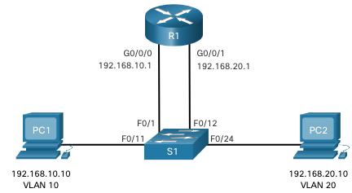
Legacy Inter-VLAN Routing
Straight forward implementation of the conceptual approach
A router with multiple physical Ethernet interfaces is used
Each router interface is connected to a switch port in different VLANs, and serves as the default gateways to the local hosts on a VLAN
This approach works but is not scalable - routers have a limited number of physical interfaces
Requiring one physical router interface per VLAN quickly exhausts the physical interface capacity of a router

Slide 53
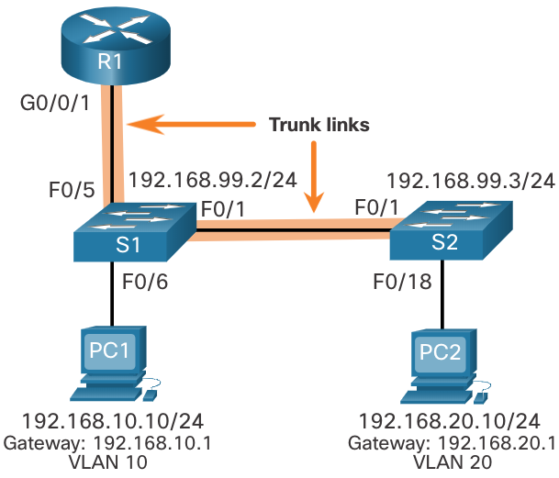
Router-on-a-Stick Inter-VLAN Routing
This approach requires one physical Ethernet interface to route traffic between multiple VLANs on a network, and is supported by Cisco routers
Ethernet interface of a router is configured as an 802.1Q trunk and connected to a trunk port on a Layer 2 switch. Specifically, the router interface is configured using subinterfaces to identify routable VLANs.
Subinterface | VLAN | IP Address
G0/0/1.10 | 10 | 192.168.10.1/24
G0/0/1.20 | 20 | 192.168.20.1/24
G0/0/1.30 | 99 | 192.168.99.1/24

Slide 54
Router-on-a-Stick Inter-VLAN Routing
The configured subinterfaces are software-based virtual interfaces. Each is associated with a single physical Ethernet interface.
Each subinterface is independently configured with an IP address and VLAN assignment. Subinterfaces are configured for different subnets that correspond to their VLAN assignment.
When VLAN-tagged traffic enters the router interface, it is forwarded to the VLAN subinterface.
After a routing decision is made, the router determines the exit interface for the traffic. If the exit interface is configured as an 802.1q subinterface, the data frames are VLAN-tagged with the new VLAN and sent back out the physical interface
This approach does not scale beyond 50 VLANs

Slide 55
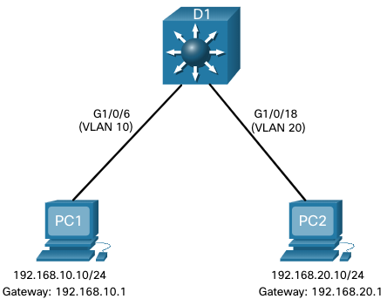
Inter-VLAN Routing on a Layer 3 Switch
This approach uses a Layer 3 switch and switched virtual interfaces (SVI).
A Layer 3 switch is also called a multilayer switch as it operates at Layer 2 and Layer 3.
An SVI is a virtual interface that is configured on a Layer 3 switch for each VLAN.
Specifically, it provides switching and routing for packets that are sent to or from all switch ports associated with that VLAN.
But Layer 3 switches are more expensive

Slide 56
802.11 Wireless LAN

Slide 57
Wireless Data Communications
Wireless communications compelling
  Easy, low-cost deployment
  Mobility & roaming: Access information anywhere
  Supports personal devices
    PDAs, laptops, data-cell-phones
  Supports communicating devices
    Cameras, location devices, wireless identification
  Signal strength varies in space & time
  Signal can be captured by snoopers
  Spectrum is limited & usually regulated

Slide 58

Ad Hoc Communications
A
C
B
D
Temporary association of group of stations
  Within range of each other
  Need to exchange information
  E.g. Presentation in meeting, or distributed computer game, or both

Slide 59
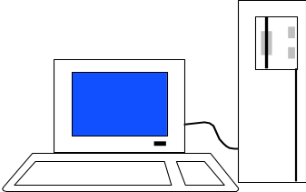
Infrastructure Network
Portal
Gateway to
the Internet
Server
Distribution System
Portal
AP1
AP2
A1
B1
A2
B2
BSS A
BSS B
Permanent Access Points provide access to Internet

Slide 60
IEEE 802.11 Wireless LAN
Stimulated by availability of unlicensed spectrum
  U.S. Industrial, Scientific, Medical (ISM) bands
  902-928 MHz, 2.400-2.4835 GHz, 5.725-5.850 GHz
Targeted wireless LANs @ 20 Mbps
MAC for high speed wireless LAN
Ad Hoc & Infrastructure networks
Variety of physical layers

Slide 61
802.11 Definitions
Basic Service Set (BSS)
  Group of stations that coordinate their access using a given instance of MAC
  Located in a Basic Service Area (BSA)
  Stations in BSS can communicate with each other
  Distinct collocated BSS’s can coexist
Extended Service Set (ESS)
  Multiple BSSs interconnected by Distribution System (DS)
  Each BSS is like a cell and stations in BSS communicate with an Access Point (AP)
  Portals attached to DS provide access to Internet

Slide 62
Infrastructure Network
Portal
Gateway to
the Internet
Server
Distribution System
Portal
AP1
AP2
A1
B1
A2
B2
BSS A
BSS B

Slide 63
Distribution Services
Stations within BSS can communicate via AP
DS provides distribution services:
  Transfer MAC SDUs between APs in ESS
  Transfer MSDUs between portals & BSSs in ESS
  Transfer MSDUs between stations in same BSS
    Multicast, broadcast, or stations’s preference
ESS looks like single BSS to LLC layer

Slide 64
Infrastructure Services
Select AP and establish association with AP
  Then can send/receive frames via AP & DS
Reassociation service to move from one AP to another AP
Dissociation service to terminate association
Authentication service to establish identity of other stations
Privacy service to keep contents secret

Slide 65
IEEE 802.11 MAC
MAC sublayer responsibilities
  Channel access
  PDU addressing, formatting, error checking
  Fragmentation & reassembly of MAC SDUs
MAC security service options
  Authentication & privacy
MAC management services
  Roaming within ESS
  Power management

